Slide 1
ZIKA
Enfermedad por Zika Virus: Mensajes Claves
Updated August 9, 2017
Notes:
Content of these slides comes from CDC’s Zika Virus Disease Key Messages (http://www.cdc.gov/zika/pdfs/zika-key-messages.pdf). Supplemental talking points are provided in the notes section throughout this presentation.

Slide 2
IntroducCion
Lo que conviene saber y transmitir acerca de la enfermedad por Zika Virus
Notes:
This presentation provides information on the current Zika outbreak, how Zika is spread, symptoms, associated risks, and how to prevent the spread of Zika.

Slide 3
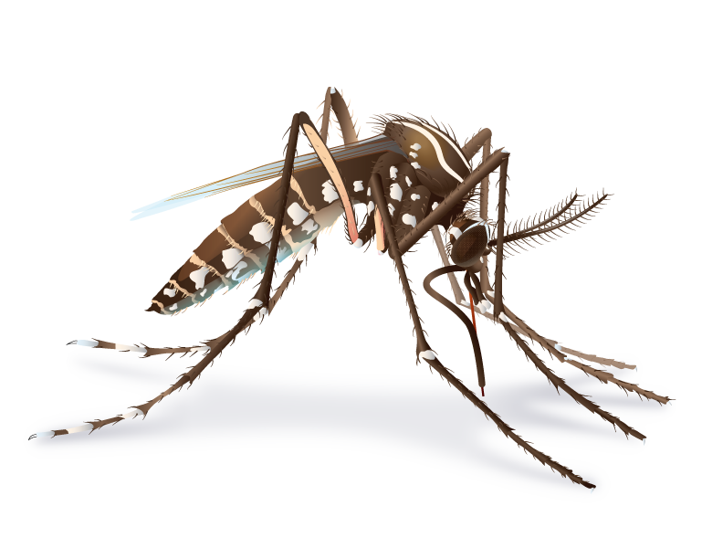
Qué es el Zika?
Zika virus se transmite los humanos por medio de la picadura del mosquito de la especie Aedes que se encuentra infectado (Ae. aegypti and Ae. albopictus).
Mucha gente infectada por Zika virus no presenta síntomas o únicamente tiene sintomatología leve.
La infección por Zika virus durante el embarazo puede provocar microcefalia y otros defectos cerebrales severos.
Notes:
Primarily through the bite of an infected Aedes aegypti or Aedes albopictus mosquito.
Many people won’t have symptoms or will only have mild symptoms.
Infection during pregnancy can cause microcephaly and other severe brain defects.

Slide 4

Where has Zika been found?
Antes de 2015, las epidemias de Zika ocurrieron en Africa, Sudeste de Asia, e islas del Pacifico.
Actualmente las epidemias están sucediendo en muchois países y territorios.
http://www.cdc.gov/zika/geo/index.html
Notes:
Historical background on Zika:
Zika virus was first discovered in a monkey in the Zika Forest of Uganda in 1947.
Before 2007, at least 14 human cases of Zika had been documented, although other cases were likely to have occurred and were not reported.
Zika outbreaks have probably occurred in many locations. Because the symptoms of Zika are similar to those of many other diseases, many cases may not have been recognized.
Since May 2015, CDC has been responding to increased reports of Zika and has assisted in investigations with PAHO and countries’ ministries of health. The first travel notice for Zika in Brazil was posted in June 2015.
On January 22, 2016, CDC activated its Emergency Operations Center (EOC) to respond to outbreaks of Zika occurring in the Americas and increased reports of birth defects and Guillain-Barré syndrome in areas affected by Zika. On February 8, 2016, CDC elevated its EOC activation to a Level 1, the highest level.
On February 1, 2016, the World Health Organization (WHO) declared a Public Health Emergency of International Concern (PHEIC) because of clusters of microcephaly and other neurological disorders in some areas affected by Zika.

Slide 5
TRANSMISIÓN Y SINTOMAS

Slide 6

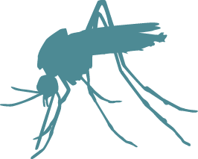
How is Zika spread?
Zika puede transmitirse por:
  Picadura de Mosquito
  De una embarazada a su feto
  Por tener sexo con persona infectada
  Exposición en un laboratorio
Zika puede transitirse por transfusiones de sangre.
No se reporta transmision a través de la lactancia materna.
Notes:
Zika virus is spread to people primarily through the bite of an infected Aedes species mosquito (Ae. aegypti and Ae. albopictus).
Mosquitoes that spread Zika virus bite during the day and night.
A pregnant woman can pass Zika virus to her fetus during pregnancy or around the time of birth.
A person infected with Zika virus can pass it to his or her sex partners.
Zika virus may be spread through blood transfusions.
Transmission of Zika virus through breast milk has not been documented. Benefits of breastfeeding outweigh theoretical risk of Zika virus transmission through breast milk.
There is no evidence that Zika is spread through touching, coughing, or sneezing.

Slide 7
How does Zika affect people?
Mucha gente infectada con Zika no tiene síntomas o presenta sintomatología leve.
Los síntomas duran de varios días a una semana.
Las personas usualmente no se sienten tan mal como para acudir a un hospital.
Muy rara vez alguien muere por Zika.
Notes:
Anyone who lives in or travels to an area with risk of Zika and has not already been infected with Zika virus can get it.
Symptoms of Zika are similar to other illnesses, like dengue and chikungunya, that spread through mosquito bites.
Many people will not have symptoms or will only have mild symptoms.
Symptoms last several days to a week.
People usually don’t get sick enough to go to the hospital.
People very rarely die of Zika.

Slide 8
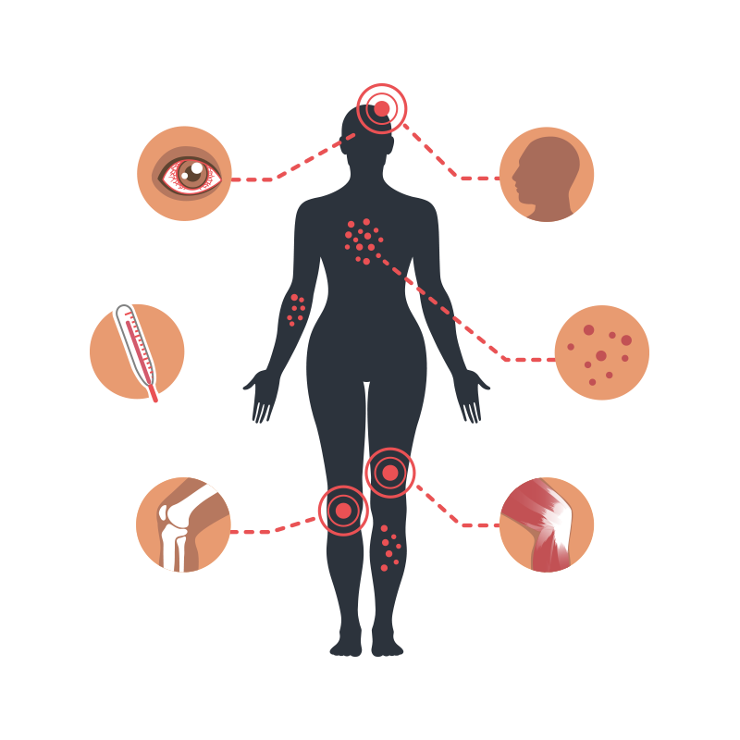
What are the symptoms?
Las personas refieren como los síntomas mas comunes del Zika, los siguientes:
  Fiebre
  Rash
  Dolor de cabeza
  Dolor de articulaciones
  Conjuntivitis (ojos rojos)
  Dolor muscular
Notes:
Anyone with possible exposure to Zika virus through travel or sexual transmission should go to a doctor or healthcare provider if they have any of the symptoms listed.
Symptoms include
Fever
Rash
headache
Joint pain
Conjunctivitis (red eyes)
Muscle pain

Slide 9
Zika Y EMBARAZO

Slide 10
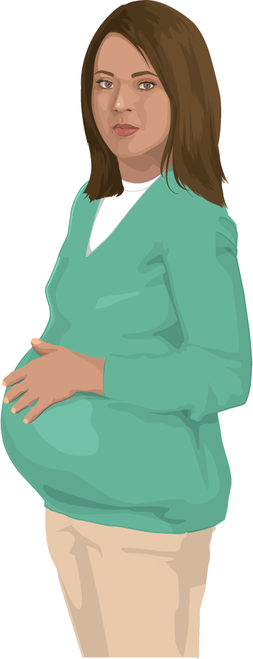
Como puede afectar el Zika al embarazo?
Zika virus puede pasar de una embarazada a su hijo durante el embarazo o durante el momento del parto.
No se sabe cuan a menudo ocurre esta transmission, que porcentaje de fetos y recién nacidos pueden ser afectados.
Notes:
We expect that women who develop Zika will have similar illness to people who are not pregnant. No evidence exists to suggest that pregnant women are more susceptible or experience more severe disease during pregnancy.
We do not know if pregnant women are more likely to develop symptoms compared to the general population.
We do not know if pregnant women are more likely to get Guillain-Barré syndrome.
We do not know how likely it is that Zika infection will affect a pregnancy.
We do not know if a baby will have birth defects if a woman is infected while pregnant.
More information on Zika and pregnancy is found here: http://www.cdc.gov/zika/pregnancy/index.html

Slide 11
Como puede afectar el Zika al embarazo?
La infección durante el embarazo puede causar lesiones cerebrales, microcefalia y Sindrome Congénito del Zika Virus (SCZV).
También se relaciona con otros problemas: abortos, mortinatos, malformaciones al nacimiento
No existe evidencia que una infección anterior afecte futuros embarazos una vez que se ha eliminado el virus del organismo
Notes:
Microcephaly is a severe birth defect that is a sign of a problem with brain development.
Microcephaly can occur because a baby’s brain has not developed properly during pregnancy or has stopped growing after birth.
Currently, there is no evidence to suggest that past Zika virus infection poses an increased risk of birth defects for future pregnancies once the virus has completely cleared a woman’s body.
More information on microcephaly and birth defects is found here: http://www.cdc.gov/zika/healtheffects/birth_defects.html

Slide 12
Como puede afectar el Zika al embarazo?
Sindrome Congenito por Zika Virus
  Varios patrones de defectos al nacimiento en fetos y niños de mujeres infectadas durante el embarazo
  Se asocial con 5 tipos de defectos al nacimiento nunca vistos o rara vez vistos con otras infecciones durante el embarazo
    Microcefalia severa (cabeza pequena) como resultado de un cráneo parcialmente colapsado
    Disminución del tejido cerebral con lesión cerebral
    Dano en el area posterior del ojo con lesiones específicas de cicatrización e hiperpigmentación
    Amplitud limitada de movimientos articulares con pie deforme
    Hipertonía muscular con restricción de movimientos inmediatamente al nacimiento.
Notes:
All infants born to mothers with laboratory evidence of Zika virus infection during pregnancy should receive a comprehensive physical exam, head ultrasound to assess the brain’s structure, standard newborn hearing assessment, and lab testing for Zika virus, even if no abnormalities are apparent at birth.
Microcephaly has been identified as one feature of a unique pattern of birth defects, called congenital Zika syndrome, among fetuses and infants of women infected with Zika during pregnancy. https://www.cdc.gov/mmwr/volumes/65/wr/mm6533e2.htm?s_cid=mm6533e2_w
Zika virus infection during pregnancy can cause birth defects including damage to the brain, microcephaly, and congenital Zika syndrome, a pattern of birth defects that includes brain abnormalities, eye defects, hearing loss, and limb defects.
Recognizing that Zika is a cause of certain birth defects does not mean that every pregnant woman infected with Zika will have a baby with a birth defect. It means that infection with Zika during pregnancy increases the chances for these problems.
Although Zika virus is a cause of microcephaly and other severe brain defects and has been linked with these other problems in infants, there is more to learn. Researchers are collecting data to better understand the extent Zika virus impact on mothers and their children.

Slide 13
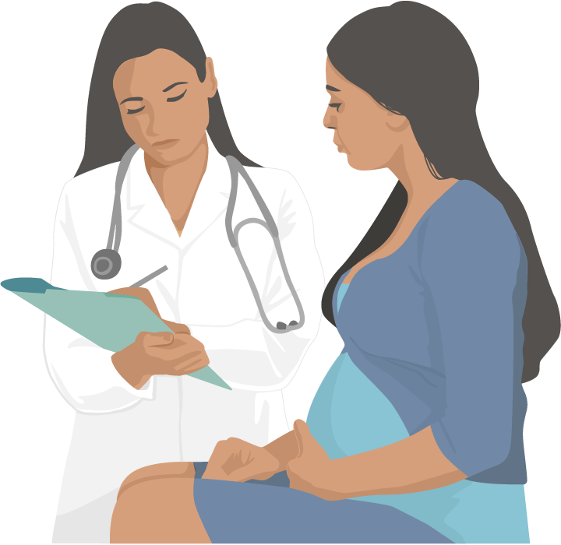
Asesoramiento a la embarazada por possible exposición al Zika
En cada control prenatal, a todas las embarazadas debe preguntárseles si ellas:
  Han viajado o viven en una zona con riesgo de Zika
  Hacon una pareja que vive o ha viajado a una zona con riesgo de Zika
Notes:
Pregnant women who live in or have recently traveled to an area with risk of Zika should talk to a doctor or other healthcare provider about their risk of Zika virus infection even if they don’t feel sick.
Pregnant women should also talk to their doctor or other healthcare provider if their sex partner lives in or recently traveled to an area with risk of Zika.
Pregnant women should see a doctor or other healthcare provider if they develop a fever, headache, rash, joint pain, muscle pain, or conjunctivitis (red eyes). They should tell the doctor or other healthcare provider where they live and where they have traveled.
Pregnant women with possible exposure to an area with risk of Zika that has a CDC Zika travel notice should be tested for Zika infection even if they do not have symptoms.

Slide 14
sIndrome DE
Guillain- barré

Slide 15
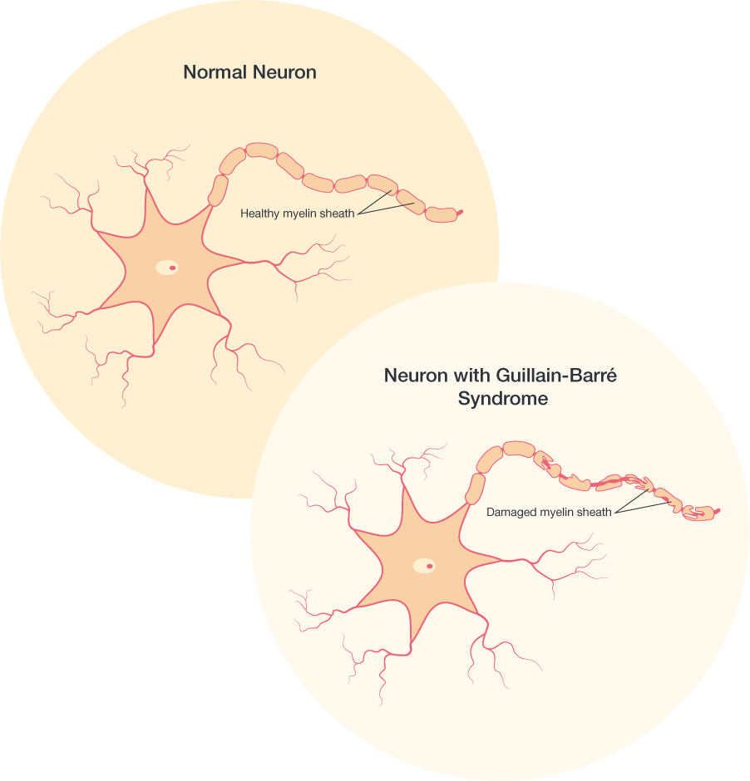
Puede Zika virus causar Sindrome de Guillain-Barré (SGB)?
SGB es una enfermedad poco comun del Sistema nervioso, en la que el propio Sistema immune de las personas dana las células nerviosas, provocando debilidad muscular y el algunas ocasiones parálisis.
SGB es altamente asociado con Zika, pero solamente una pequena proporción de personas con infección reciente por Zika desarrollan SGB.
CDC continua investigando la relación entre SGB y Zika para saber mas al respecto.
Notes:
Several countries that have experienced Zika outbreaks recently have reported increases in people who have Guillain-Barré syndrome (SGB).
SGB symptoms include weakness of the arms and legs and, in severe cases, can affect the muscles that control breathing.
These symptoms can last a few weeks or several months. Most people fully recover from SGB, though some people have permanent damage. Very few people die from SGB.
Researchers do not fully understand what causes SGB. Most people with SGB report an infection before they have SGB symptoms. CDC is continuing to investigate the link between SGB and Zika to learn more.

Slide 16
EVALLUACION

Slide 17
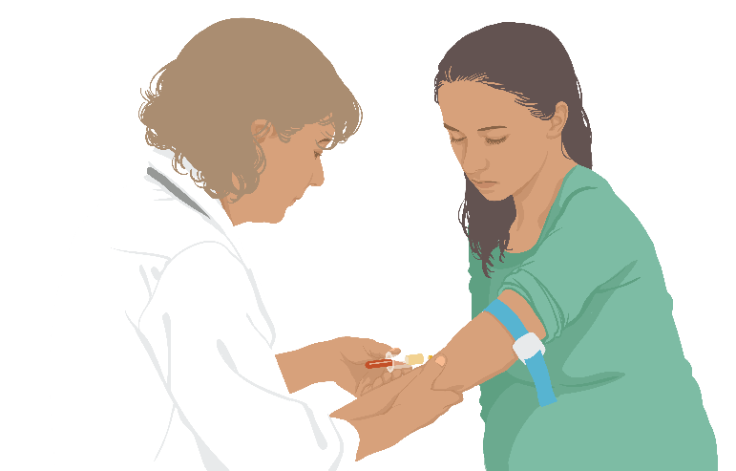
Como se diagnostic el Zika?
Un doctor u otro proveedor de salud pregunta acerca de cualquier viaje reciente y la presencia de signos y sintomas.
Un examen de sangre o de orina puede confirmer la infección por Zika.
Notes:
A doctor or other healthcare provider will ask about any recent travel and any signs and symptoms.
Testing blood, semen, vaginal fluids, or urine is not recommended to determine how likely a person is to pass Zika virus through sex. Because Zika virus can remain in some fluids (for example, semen) longer than blood, someone might have a negative blood test, but still carry Zika in their genital secretions. Testing semen and vaginal fluids for Zika virus is not currently available outside of the research setting. Testing is not recommended for asymptomatic men and women who are not pregnant.
Detailed testing guidance is found here: http://www.cdc.gov/mmwr/volumes/65/wr/pdfs/mm6529e1.pdf

Slide 18
A quien se le deben realizar exámenes para Zika?
Cualquier persona que tengo o haya tenido recientemete signos y síntomas de Zika:
  Y que viva o hubiera viajado a alguna área con riesgo de Zika, o
  Hubiera tenido sexo sin protección con una pareja que viva o hubiera viajado a alguna área con riesgo de Zika
Notes:
Detailed testing information can be found here
https://www.cdc.gov/zika/hc-providers/testing-for-zikavirus.html
Updated guidance on testing of pregnant women can be found here
https://www.cdc.gov/mmwr/volumes/65/wr/mm6529e1.htm?s_cid=mm6529e1_e

Slide 19
A quien se le deben realizar exámenes para Zika?
Embarazadas que viven o viajan frecuentemente a áreas con riesgo de Zika
Embarazadas que tienen un feto con signos consistentes de infección congénita por Zika, en el ultrasonido,y
  Viven o viajan a cualquier área con riesgo de Zika, o
  Hubiera tenido sexo sin protección con una pareja que viva o viaje a cualquier área con riesgo de Zika
Notes:
Pregnant women who live in an area with a Zika travel notice are at risk of getting Zika throughout pregnancy. For this reason, testing should be offered at the first prenatal care visit, followed by two rounds of testing at regular prenatal care visits during the pregnancy.
Pregnant women exposed to Zika who do NOT have symptoms are not recommended to receive routine t
Zika virus testing is not recommended for
Non-pregnant asymptomatic individuals
Preconception screening

Slide 20
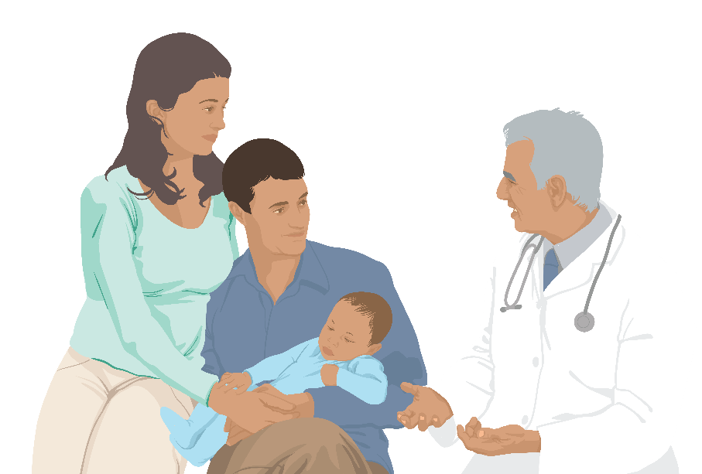
Examinando a los bebés para Zika
CDC recomienda realizer exámenes de laboratorio para:
Todos los hijos de madres con evidencia demostrada por laboratorio de infección por Zika virus durante el embarazo
Niños con hallazgos clínicos o radiológicos sugestivos de SCZV y su madre con possible exposición al Zika virus, independientemente de los resultados maternos para Zika virus
Notes:
Infant samples for Zika virus testing should be collected ideally within the first 2 days of life; if testing is performed later, distinguishing between congenital, perinatal, and postnatal infection will be difficult.

Slide 21
QUE HACER AL SER INFECTADO

Slide 22
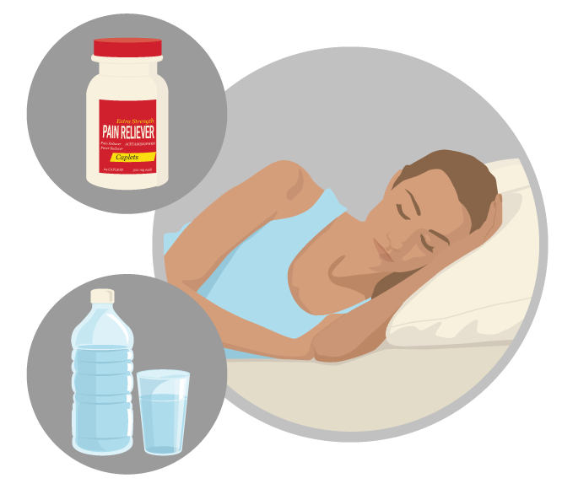
Como se trata el Zika?
No hay medicamentos específicos o vacuna para tartar la infacción por Zika virus.
Tratar los síntomas
  Descansar
  Beber líquidos para prevenir deshidratación
  No tomar aspirina u otros antiinflamatorios no esteoidales (AINES)
  Tomar acetaminofén para reducir fiebre y dolor
Notes:
No specific medicine for Zika
Treat the symptoms
Do not take aspirin or other non-steroidal anti-inflammatory drugs (NSAIDS) until dengue can be ruled out to reduce the risk of bleeding.
If you are taking medicine for another medical condition, talk to your doctor or other healthcare provider before taking additional medication.

Slide 23
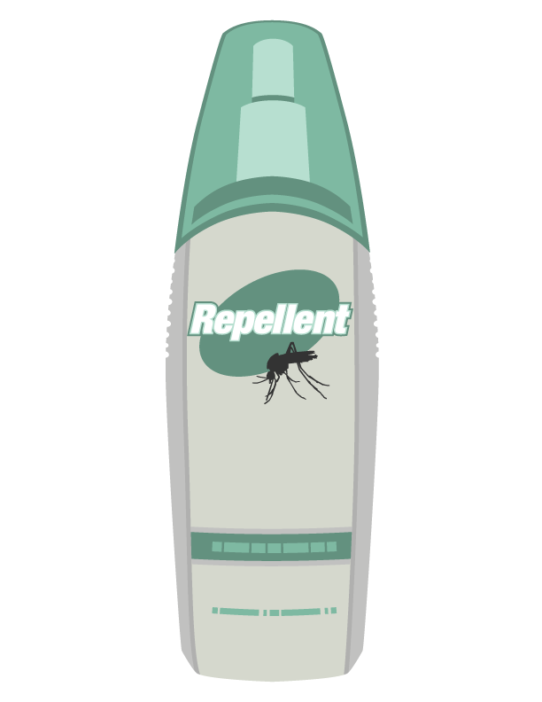
Que hacer si usted tiene Zika
Protéjase uste mismo de laspicaduras de mosquito. Durante la primera semana de la enfermedad, el Zika virus puede encontrarse en la sangre.
El virus puede pasarse de una persona infectada al mosquito mediante la picadura.
Un mosquito infectado puede transmitir el virus a otras personas.
Notes:
To help prevent others from getting sick, strictly follow steps to prevent mosquito bites during the first week of illness.

Slide 24
VIGILANCIA

Slide 25
Reportando el Zika
El personal de salud debe reportar sus casos a su departamento de salud territorial correspondiente.
Los países y los niveles territoriales deben reportar y tartar de confirmar los casos a las redes nacionales e internacionales de vigilancia entre ellas CDC, ArboNET.
Las embarazadas con possible evidencia por laboratorio de infección por Zika debe reportarse de inmediato
For the most recent case counts, visit https://www.cdc.gov/zika/geo/united-states.html.
Notes:
Zika is a nationally notifiable disease. State and territorial health departments are encouraged to report laboratory-confirmed cases to CDC through ArboNET, the national surveillance system for arboviral diseases. Healthcare providers should report cases to their local, state or territorial health department according to the laws or regulations for reportable diseases in their jurisdiction.
CDC maintains enhanced surveillance of women with any laboratory evidence of possible Zika virus infection, with or without symptoms, during pregnancy and their babies for the first year of life.
CDC watches for and reports the number of Zika cases and the areas where Zika is spreading, which will help improve our understanding of how and where Zika is spreading.

Slide 26
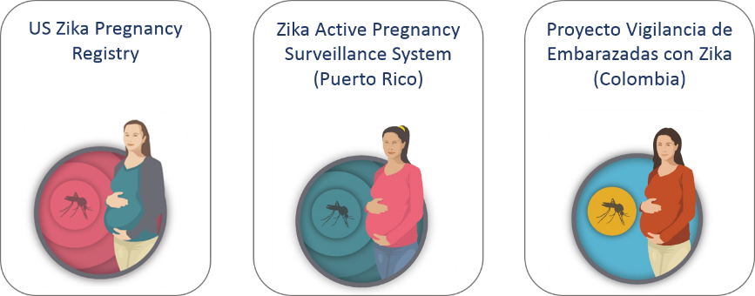
Registro de embarazos con Zika
Notes:
To learn more about the impact of Zika infection on pregnant women, their fetuses, and infants, CDC is conducting enhanced surveillance for women with evidence of possible Zika virus infection during pregnancy.
With state, tribal, local and territorial health departments, CDC established the US Zika Pregnancy Registry.
CDC also helped develop a similar system in Puerto Rico, the Zika Active Pregnancy Surveillance System.
CDC provided assistance to establish enhanced surveillance of pregnant women with Zika in Colombia.
Data collected will be used to update recommendations for clinical care, plan for services for pregnant women and families affected by Zika, and improve prevention of Zika infection during pregnancy

Slide 27
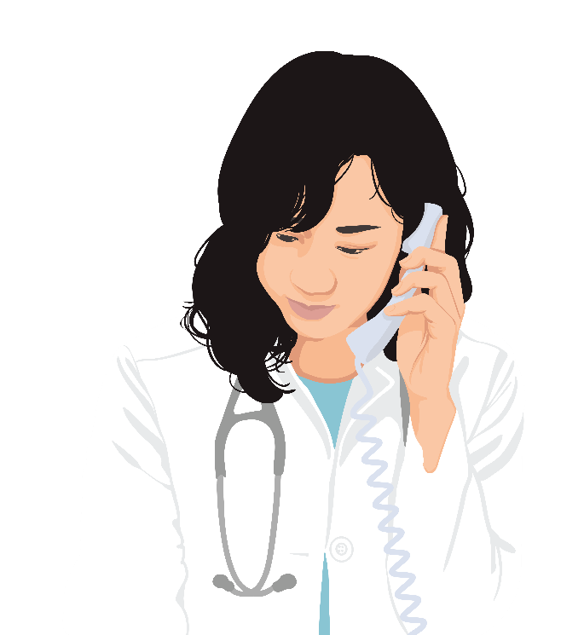
Recomendaciones de registro de embarazadas con Zika
CDC ha establecido un registro de embarazadas y Zika para USA con e fin de recolectar información y aprender más acerca del problema en embarazo y en niños.
Datos se usarán para
  Actualizar recomendaciones en cuidado clínico
  Planes para los servicios de embarazadas y familia afectadas por Zika
  Mejorar la prevención de lainfección por Zika durante el embarazo
Existe un Sistema activo de vigilancia para el Zika en Puerto Rico.
https://www.cdc.gov/zika/hc-providers/registry.html
https://www.cdc.gov/zika/public-health-partners/zapss.html
Notes:
CDC established the US Zika Pregnancy Registry and is collaborating with state, tribal, local, and territorial health departments to collect information about - pregnancy and infant outcomes among pregnant women with laboratory evidence of Zika virus infection and their infants.
CDC reports pregnancy data from these two surveillance systems. The numbers reported reflect counts of pregnant women in the US, including US territories, with any laboratory evidence of possible Zika virus infection, with or without symptoms or pregnancy complications.

Slide 28
prevenCiÓn
Protegerse de la picadura de mosquitos

Slide 29
Zika es primariamente transmitido por la picadura de un mosquito Aedes aegypti o Ae. Albopictus infectado. Tome medidas para protegerse usted y a los demás.
Notes:
Zika virus is primarily spread through the bite of an Aedes aegypti or Aedes albopictus mosquito.
Aedes aegypti mosquitoes live in tropical, subtropical, and in some temperate climates. They are the primary vector of Zika, dengue, chikungunya, and other arboviral diseases. Because Aedes aegypti mosquitoes live near and prefer to feed on people, they are considered highly efficient at spreading these diseases.
To produce eggs, the female mosquito bites people to feed on blood. When feeding, a mosquito will pierce the skin (like a needle) and inject saliva into a person’s skin.

Slide 30

Control de mosquitos en el exterior
Esto es lo que se debe hacer para controlar la presencia de mosquitos fuera de su hogar
  Una vez por semana, vacie y barra, voltee,cubra o tire las cosas que puedan contener y ser reservorios de agua.
  Cierre herméticamente los depósitos de aguaa.
  Use larvicids para matar las larvas en los reservorios de agua que nopuede ser vaciasda y que no se usará para beber.
  Fumigue con insecticida para exteriores, fuera de la casa, para matar los mosquitos en las zonas donde éstos se reunen o reposan.
  Si tiene un tanque séptico, repare las fisuras o fugas.
Notes:
Once a week, empty and scrub, turn over, cover, or throw out any items that hold water like tires, buckets, planters, toys, pools, birdbaths, flowerpot saucers, or trash containers. Mosquitoes lay eggs near water.
Tightly cover water storage containers (buckets, cisterns, rain barrels) so that mosquitoes cannot get inside to lay eggs.
For containers without lids, use wire mesh with holes smaller than an adult mosquito.
Use larvicides to kill larvae in containers of water that will not be used for drinking and cannot be covered or dumped out.
If you have a septic tank, repair cracks or gaps. Cover open vent or plumbing pipes. Use wire mesh with holes smaller than an adult mosquito.
Use an outdoor insect spray made to kill mosquitoes in areas where they rest. Mosquitoes rest in dark, humid areas like under patio furniture, or under the carport or garage.

Slide 31
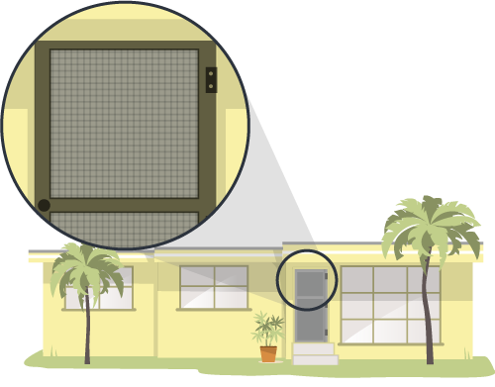
Control de mosquitos dentro de casa
Esto es lo que se debe hacer para controlar los mosquitos dentro de su hogar:
  Coloque mallas en las puertas y ventanas.
  Use aire acondicionado de ser posible
  Una vez por semana, vacie, barra, voltee o tire las cosas que contienen agua.
  Si tiene mosquitos dentro de la casa, use un spray de insecticida para interiores.
    Cuando utilice insecticidas, siga estrictamente las instrucciones.
Notes:
Install or repair and use window and door screens. Do not leave doors propped open.
Use air conditioning when possible.
Once a week, empty and scrub, turn over, cover, or throw out any items that hold water like vases and flowerpot saucers. Mosquitoes lay eggs near water.
Kill mosquitoes inside your home. Use an indoor insect fogger or indoor insect spray to kill mosquitoes and treat areas where they rest. These products work immediately, and may need to be reapplied. When using insecticides, always follow label directions. Only using insecticide will not keep your home free of mosquitoes.
Mosquitoes rest in dark, humid places like under the sink, in closets, under furniture, or in the laundry room.

Slide 32
Usar repelente para insectos
Use solamente repelentes registrados.
  Use repelent con alguno de los siguoentes ingredients activos : DEET, picaridin, IR3535, o aceite de limón-eucalyptus, para-menthane-diol, o 2-undecanone.
Siga estrictamente las instrucciones de la etiqueta del producto.
No aplique el spray repelente directamente sobre la piel, bajo la ropa.
Si usa protector solar al mismo tiempo, apliquelo antes de aplicar el insecticida repelente.
Notes:
Choosing an EPA-registered repellent ensures the EPA has evaluated the product for effectiveness.
Insect repellents registered by the EPA repel the mosquitoes that spread Zika and other viruses like dengue, chikungunya, and West Nile.
When used as directed, EPA-registered insect repellents are proven safe and effective even for pregnant and breastfeeding women.

Slide 33
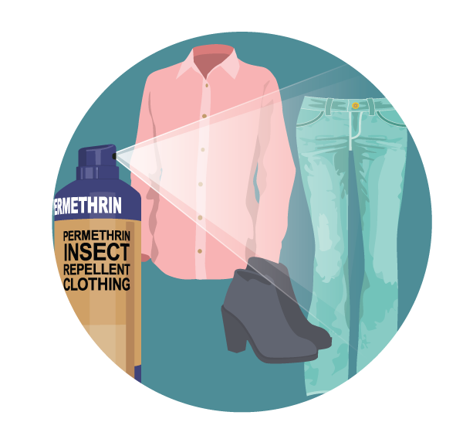
Cree una barrera entre usted y los mosquitos
Cubra la piel expuesta
  Use camisas de manga larga y pantalones largos, mejor de color claro.
Trate las prendas de vestir y equipos
  Use permethrin* para impregnar prendas de vestir y equipos o compre materiales pretratados.
  Lea las instrucciones para conocer cuanto tiempo dura la protección
  No use permethrin directamente sobre la piel.
Notes:
The EPA has reviewed scientific studies on the use of permethrin-treated clothing. Based on EPA’s review, there is no evidence of reproductive or developmental effects to mother or child following exposure to permethrin.
Treated clothing remains protective after multiple washings. See product information to learn how long the protection will last.
If treating items yourself, follow the product instructions carefully.
Do NOT use permethrin products directly on skin. They are intended to treat clothing.

Slide 34
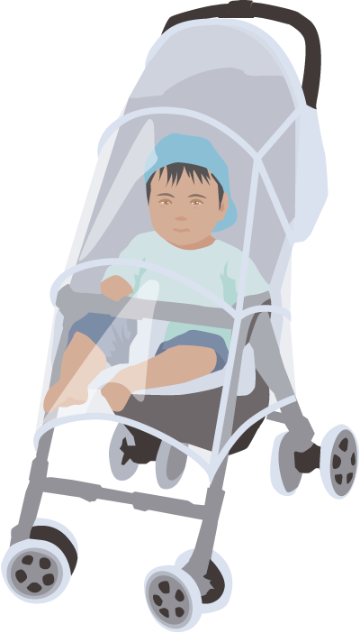
Proteja su familia
Para niños
  Vista a sus niños con ropa que les cubra brazos y piernas.
  Para niños mayores de dos meses use repelente en las áreas expuestas de la piel.
  Cubra las cunas, coches y portabebés con mosquiteros.

Slide 35
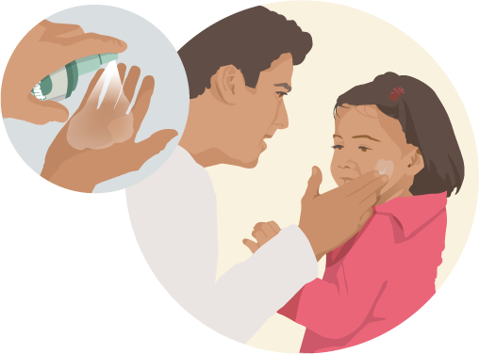
Proteja su familia
Aplicando repelente de insectos en niños
  No aplique repelente en manos, ojos, boca, o en piel irritada o cortada.
  Adultos: Ponga el spray primero en sus manos y luego aplique a los niños en cara u otros.
  No use repelente en menores de dos meses.
  No use productos que contengan acetide de limon-eucalyptus o para-menthane-diol en niños menores de 3 años.

Slide 36
prevenCiÓn
Prevención de la transmisión sexual

Slide 37
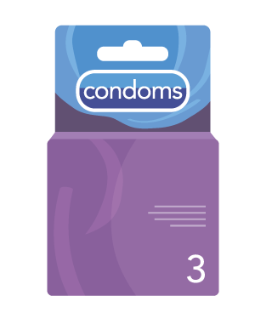

Acerca de la transmisión sexual
Zika puede transmitirse por vía sexual de una persona con Zika a sus compañeros sexuales.
  Sexo incluye vaginal, anal, y sexo oral así como al compartir juguetes sexuales.
  Zika puede transmitirse antes, durante y despues de la presencia de síntomas.
  Puede transmitirse aunque la persona no presente o incluso no desarrolle síntomas.
Zika virus puede permanecer mas tiempo en semen que en otros fluidos como vaginal, orina, y sangre.
Notes:
Zika can be passed through sex from a person who has Zika to his or her sex partners.
Sex includes vaginal, anal, and oral sex, and the sharing of sex toys.
Zika can be passed through sex, even if the infected person does not have symptoms at the time.
It can be passed from a person with Zika before their symptoms start, while they have symptoms, and after their symptoms end.
Although not well documented, the virus may also be passed by a person who carries the virus but never develops symptoms.
Studies are underway to find out how long Zika stays in the semen and vaginal fluids of people who have Zika and how long it can be passed to sex partners. We know that Zika can remain in semen longer than in other body fluids, including vaginal fluids, urine, and blood.
Sexual exposure includes sex without a condom with a person who traveled to or lives in an area with Zika.
This includes vaginal, anal, and oral sex and the sharing of sex toys.

Slide 38
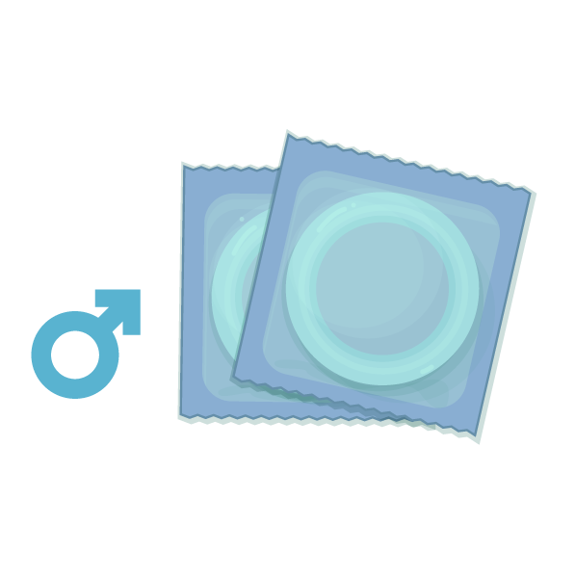

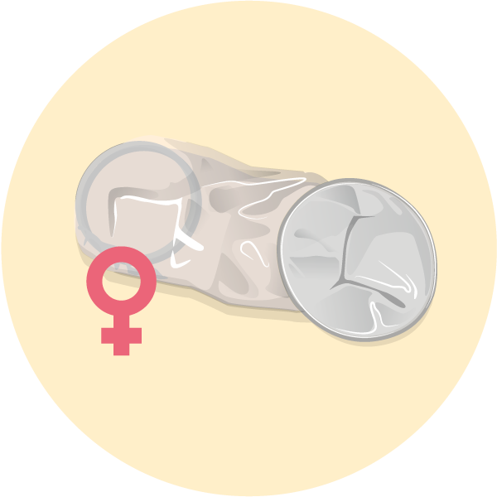
Proteja a su pareja
Al no tener sexo se elimina el riesgo de contagiar por esta vía.
Condones pueden reducer el riesgo de contagion del Zika por vía sexual.
  Incluye condón masculino y femeniño.
  Condones deben ser utilizados desde el principio hasta el final de la relación y cada vez, sea esta vaginal, anal, sexo oral y al compartir juguetes sexuales.
http://www.cdc.gov/mmwr/volumes/65/wr/pdfs/mm6529e2.pdf
Notes:
Not sharing sex toys may also reduce the risk of spreading Zika to sex partners.
The full sexual transmission guidance can be found here: http://www.cdc.gov/mmwr/volumes/65/wr/pdfs/mm6529e2.pdf

Slide 39

Proteja a su pareja
Las personas con una pareja que ha viajado a un área con riesgo de Zika debe usar condón o no tener sexo
  Si el viajero es una mujer: Al menos 8 semanas después de su regreso, o después de presentar síntomas o ser diagnosticada
  Si el viajero es hombre: Al menos por 6 meses despues de su regreso , o después de presentar síntomas o ser diagnosticado
Personas que viven en áreas de riesgo de Zika pueden usar condones o no tener sexo.
Notes:
The extended period for men is because Zika stays in semen longer than in other body fluids.
Decisions about having sex and using condoms depend on each person’s understanding of the risks and benefits, including
▪ The mild nature of the illness for many people
▪ Their possible exposure to mosquitoes while in an area with risk of Zika
▪ Their plans for pregnancy (if appropriate) and access to birth control
▪ Their access to condoms
▪ Their desire for intimacy, including willingness to use condoms or not have sex
▪ Their ability to use condoms or not have sex
o If either partner develops symptoms of Zika or has concerns, they should talk to a healthcare provider.

Slide 40
Durante el embarazo
Parejas embarazadas en las cuales uno de sus miembros vive o viaja a un área con riesgo de Zika debería:
  Usar condón de principio a fin de la relación cada vez que tienen sexo (oral, vaginal, o anal) o no tener sexo durante el embaraazo.
  No compartir juguetes sexuales durante el embarazo.
Notes:
The risk from sex is of greatest concern for pregnant women, who can pass Zika to their developing fetus if infected during pregnancy.

Slide 41
Si usted está pensando tener un bebé
Exposición debida a viajar o haber tenido sexo sin protección con alguien que vive o viaja a un lugar con riesgo de Zika
Mujer | Hombre
Esperar al menos 8 semanas después de inicio de los síntomas o de la possible exposición, antes de intentar quedar embarazada | Esperar al menos 6 meses después de inicio de los síntomas o de la possible exposición, antes de intentar concebir con su pareja.
Notes:
Women and their partners thinking about pregnancy should consider avoiding nonessential travel to areas with risk of Zika with CDC Zika travel notices.
If the female partner was exposed to this area, wait at least 8 weeks after the last possible exposure or after symptoms start (if she developed symptoms) before trying to conceive. During this waiting period, use condoms or do not have sex.
If the male partner was exposed to this area, wait at least 6 months after the last possible exposure or after symptoms start (if he developed symptoms) before trying to conceive. During this waiting period, use condoms or do not have sex.
Decisions about pregnancy planning are personal and complex, and the circumstances will vary for women and their partners. Women and their partners should discuss pregnancy planning with a trusted doctor or healthcare provider. As part of counseling with healthcare providers, some women and their partners living in areas with risk of Zika might decide to delay pregnancy.
The full sexual transmission guidance can be found here: http://www.cdc.gov/mmwr/volumes/65/wr/pdfs/mm6529e2.pdf

Slide 42
Si usted está pensando tener un bebé
Exposición debida a viajar o haber tenido sexo sin protección con alguien que vive o viaja a un lugar con riesgo de Zika
Mujer | Hombre
Si no tiene síntomas hable con el trabajador de salud acerca de los planes de embarazarse. |  | Si no tiene síntomas hable con el trabajador de salud acerca de los planes de embarazarse.
Esperar al menos 8 semanas después de inicio de los síntomas, antes de intentar quedar embarazada |  | Esperar al menos 6 meses después de inicio de los síntomas o de la possible exposición, antes de intentar el embarazo
Notes:
Because the level of risk in this area is unknown and information is limited about the risk of infection around the time of conception, talk with your healthcare provider about your plans for pregnancy, your travel plans, your risk of Zika virus infection, the possible health effects of Zika virus infection on a baby, and ways to protect yourself from Zika.
If either of you develops symptoms consistent with Zika and/or test positive for Zika, you should follow the suggested timeframes above before trying to conceive.

Slide 43
Si usted está pensando tener un bebé
Personas viviendo ofrecuentemente viajando a un área con riesgo de Zika
Mujer | Hombre
Si no tiene síntomas hable con el trabajador de salud acerca de los planes de embarazarse. | Si no tiene síntomas hable con el trabajador de salud acerca de los planes de embarazo.
Si no tiene síntomas hable con el trabajador de salud acerca de los planes de embarazarse | Si no tiene síntomas hable con el trabajador de salud acerca de los planes de embarazarse
Notes:
Men and women who live in areas with risk of Zika who are considering pregnancy in the near future should talk with their healthcare providers about their pregnancy plans during a Zika virus outbreak, the potential risks of Zika, and how they can prevent Zika virus infection during pregnancy.
If you develop symptoms of Zika and test positive for Zika, you should follow the suggested timeframes above before trying to conceive.

Slide 44
prevenCIÓN
Viajes

Slide 45
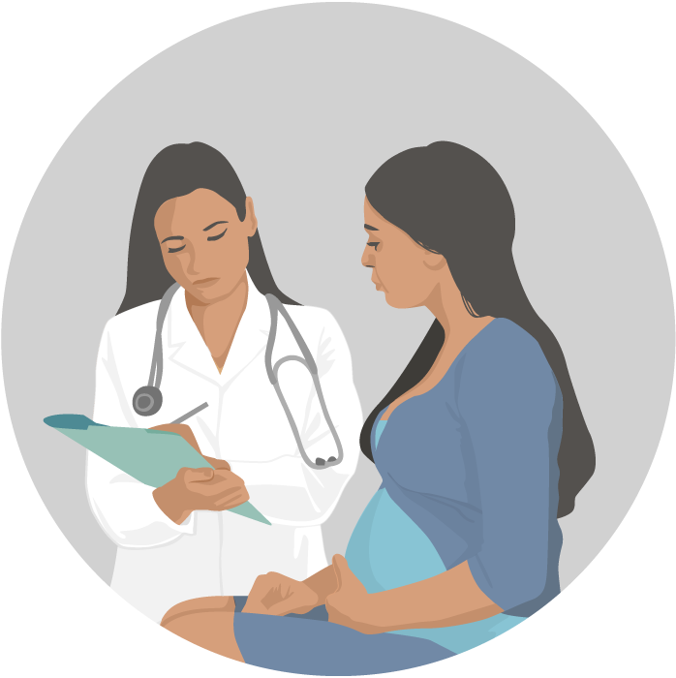

Guía de viaje para mujeres embarazadas
Si está embarazada no viaje a lugares con riesgo de Zika.
Si usted debe viajar, dígaselo a su doctor o proveedor de salud y siga estrictamente los pasos para prevenir las picaduras de mosquitos durante el viaje.
Notes:
Pregnant couples with a partner who traveled to an area with risk of Zika should:
Use condoms from start to finish every time they have sex or not have sex during the pregnancy. This is important, even if the pregnant woman’s partner does not have symptoms of Zika or feel sick.
Not share sex toys throughout the entire pregnancy.
Until more is known, CDC recommends the following:
Women trying to get pregnant and their partners
Before you or your partner travel, talk to your doctor or other healthcare provider about your plans to become pregnant and the risk of Zika virus infection.
If you do travel to an area with Zika, you and your partner should strictly follow steps to prevent mosquito bites during the trip.

Slide 46
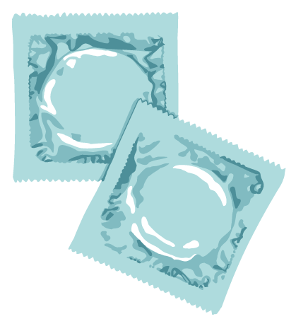
Protéjase a si misma durante el viaje
Si usted viaja a un lugar con riesgo de Zika
  Siga estrictamente los pasos para prevenir picaduras de mosquitos.
  Use condones o no tenga sexo durante el viaje.
Notes:
People with a partner who traveled to an area with risk of Zika should use condoms or not have sex. The period of time for taking these precautions depends on whether the traveler is female or male:
If traveler is female: Use condoms or do not have sex for at least 8 weeks after travel to an area with risk of Zika (if she doesn’t have symptoms) or for at least 8 weeks from the start of her symptoms (or Zika diagnosis).
If traveler is male: Use condoms or do not have sex for at least 6 months after travel to an area with risk of Zika (if he doesn’t have symptoms) or for at least 6 months from the start of his symptoms (or Zika diagnosis). This extended period is because Zika stays in semen longer than in other body fluids.
Some travelers become infected while traveling but do not get sick until they return home. Be aware of any illness or symptoms during your trip or after you return home. Tell your doctor or other healthcare provider where you have traveled and when you were there

Slide 47

Protéjase a si misma durante el viaje
Duerma en lugares con aire acondicionado y/o mallas en puerts y ventanas.
Use un toldo si no puede disponer de aire acondicionado y/o mallas de protección, o cuando tenga que dormir en exteriores.

Slide 48
Protéjase a si misma durante el viaje
Incluso sin sentirse enfermos lo viajeros que regresen de lugares con riesgo de Zika deben tomar los pasos de precaución para prevenir picaduras de mosquitos por 3 semanas para evitar transmitirles el virus del Zika a mosquitos no infectados.

Slide 49
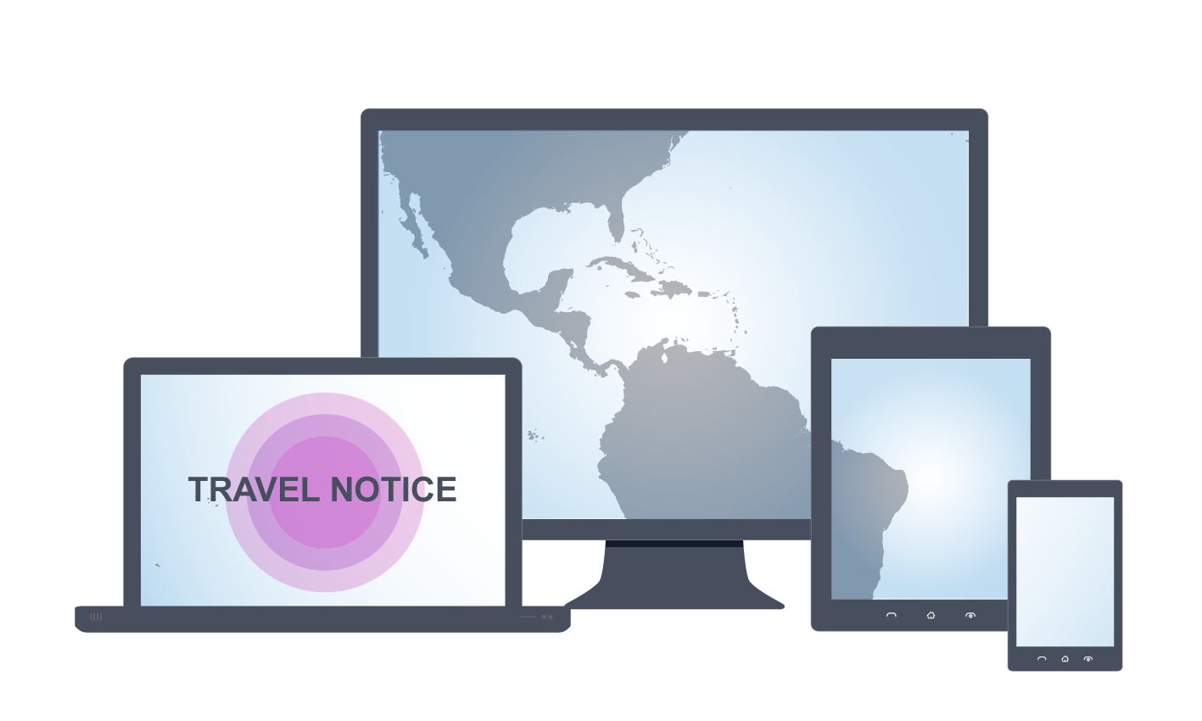
Do your homework before traveling
See the latest travel notices at:
wwwnc.cdc.gov/travel/page/zika-travel-information

Slide 50
For more information, contact CDC
1-800-CDC-INFO (232-4636)
TTY: 1-888-232-6348 www.cdc.gov
The findings and conclusions in this report are those of the authors and do not necessarily represent the official position of the Centers for Disease Control and Prevention.
TRADUCCIÓN A PARTIR DEL ARCHIVO DE USO PUBLICO DE CDC

